Slide 1
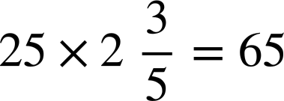





Deepening understanding of multiplication with fractions
Task A: Multiplying by a mixed number
1) Calculate the answers to the following: Give all answers in their simplest form.
a)
b)
c)
d)
e)
f)

Slide 2





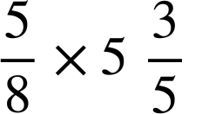
Deepening understanding of multiplication with fractions
Task B: Comparing strategies
1) Calculate the following. Try to use the most efficient method.
a)
b)
c)
d)
e)
f)
Mathematics in Education and Industry
v2.1

